Slide 1
Week 9
Knowledge Tracing

Slide 2
Goal of Knowledge Tracing
Measuring what a student knows at a specific time
Measuring what relevant knowledge components a student knows at a specific time

Slide 3
Knowledge Component
Anything a student can know that is meaningful to the current learning situation
Skill
Fact
Concept
Principle
Schema
http://www.learnlab.org/research/wiki/index.php/Knowledge_component

Slide 4
Why is it useful to measure student knowledge?
Enhancing student knowledge is the primary goal of a lot of education
If you can measure it, you know whether you’re making it better
If you can measure it, you can inform instructors (and other stakeholders) about it
If you can measure it, you can make automated pedagogical decisions

Slide 5
Different than measuring performance
Inferring if a student’s performance right now is associated with successfully demonstrating a skill
Not the same as knowing whether the student has a skill, which is not directly observable
Maybe they appeared to demonstrate skill without having it (“guess”)
Maybe they appeared to not demonstrate skill despite having it (“slip”)

Slide 6
How do we get at latent knowledge?
We can’t measure it directly
We can’t look directly into the brain
Yet
But we can look at performance
And we can look at performance over time
More information than performance at one specific moment

Slide 7
Not trivial…
This is a research problem with a long history…

Slide 8
This week
I will cover some of the key approaches for knowledge tracing, within EDM

Slide 9
First Up
Bayesian Knowledge Tracing

Slide 10
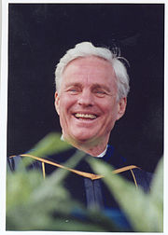
Bayesian Knowledge Tracing (BKT)
The classic approach for measuring tightly defined skill in online learning
First proposed by Richard Atkinson
Most thoroughly articulated and studied by Albert Corbett and John Anderson

Slide 11
Bayesian Knowledge Tracing (BKT)
Been around a long time
Still (as of this recording, Fall 2023) the most widely-used knowledge tracing algorithm used at scale
Interpretable
Predictable
Decent performance

Slide 12
The key goal of BKT
Measuring how well a student knows a specific skill/knowledge component at a specific time
Based on their past history of performance with that skill/KC

Slide 13
Skills should be tightly defined
Unlike approaches such as Item Response Theory (later this week)
The goal is not to measure overall skill for a broadly-defined construct
Such as arithmetic
But to measure a specific skill or knowledge component
Such as addition of two-digit numbers where no carrying is needed

Slide 14
What is the typical use of BKT?
Assess a student’s knowledge of skill/KC X
Based on a sequence of items that are dichotomously scored
E.g. the student can get a score of 0 or 1 on each item
Where each item corresponds to a single skill
Where the student can learn on each item, due to help, feedback, scaffolding, etc.

Slide 15
Key Assumptions
Each item must involve a single latent trait or skill
Different from PFA, which we’ll talk about next lecture
Each skill has four parameters
Only the first attempt on each item matters
i.e. is included in calculations

Slide 16
Key Assumptions
From these parameters, and the pattern of successes and failures the student has had on each relevant skill so far
We can compute
Latent knowledge P(Ln)
The probability P(CORR) that the learner will get the item correct

Slide 17
Key Assumptions
Two-state learning model
Each skill is either learned or unlearned
In problem-solving, the student can learn a skill at each opportunity to apply the skill
A student does not forget a skill, once he or she knows it

Slide 18
Model Performance Assumptions
If the student knows a skill, there is still some chance the student will slip and make a mistake.
If the student does not know a skill, there is still some chance the student will guess correctly.

Slide 19
Classical BKT
Not learned
p(T)
Learned
p(L₀)
p(G)
1-p(S)
correct
correct
Two Learning Parameters
p(L₀) Probability the skill is already known before the first opportunity to use the skill in problem solving.
p(T) Probability the skill will be learned at each opportunity to use the skill.
Two Performance Parameters
p(G) Probability the student will guess correctly if the skill is not known.
p(S) Probability the student will slip (make a mistake) if the skill is known.

Slide 20
Classical BKT
Not learned
p(T)
Learned
p(L₀)
p(G)
1-p(S)
correct
correct
Two Learning Parameters
p(L₀) Probability the skill is already known before the first opportunity to use the skill in problem solving.
p(T) Probability the skill will be learned at each opportunity to use the skill.
Two Performance Parameters
p(G) Probability the student will guess correctly if the skill is not known.
p(S) Probability the student will slip (make a mistake) if the skill is known.

Slide 21
Classical BKT
Not learned
p(T)
Learned
p(L₀)
p(G)
1-p(S)
correct
correct
Two Learning Parameters
p(L₀) Probability the skill is already known before the first opportunity to use the skill in problem solving.
p(T) Probability the skill will be learned at each opportunity to use the skill.
Two Performance Parameters
p(G) Probability the student will guess correctly if the skill is not known.
p(S) Probability the student will slip (make a mistake) if the skill is known.

Slide 22
Classical BKT
Not learned
p(T)
Learned
p(L₀)
p(G)
1-p(S)
correct
correct
Two Learning Parameters
p(L₀) Probability the skill is already known before the first opportunity to use the skill in problem solving.
p(T) Probability the skill will be learned at each opportunity to use the skill.
Two Performance Parameters
p(G) Probability the student will guess correctly if the skill is not known.
p(S) Probability the student will slip (make a mistake) if the skill is known.

Slide 23
Classical BKT
Not learned
p(T)
Learned
p(L₀)
p(G)
1-p(S)
correct
correct
Two Learning Parameters
p(L₀) Probability the skill is already known before the first opportunity to use the skill in problem solving.
p(T) Probability the skill will be learned at each opportunity to use the skill.
Two Performance Parameters
p(G) Probability the student will guess correctly if the skill is not known.
p(S) Probability the student will slip (make a mistake) if the skill is known.

Slide 24
Predicting Current Student Correctness
PCORR = P(Ln)*P(~S)+P(~Ln)*P(G)

Slide 25
Bayesian Knowledge Tracing
Whenever the student has an opportunity to use a skill
The probability that the student knows the skill is updated
Using formulas derived from Bayes’ Theorem.

Slide 26
Formulas

Slide 27
Example
P(L₀) = 0.4, P(T) = 0.1, P(S) = 0.3, P(G) = 0.2
Actual | P(L_{n-1}) | P(L_{n-1}|actual) | P(L_{n})
 | 0.4

Slide 28
Example
P(L₀) = 0.4, P(T) = 0.1, P(S) = 0.3, P(G) = 0.2
Actual | P(L_{n-1}) | P(L_{n-1}|actual) | P(L_{n})
0 | 0.4 | (0.4)(0.3) (0.4)(0.3)+(0.6)(0.8)

Slide 29
Example
P(L₀) = 0.4, P(T) = 0.1, P(S) = 0.3, P(G) = 0.2
Actual | P(L_{n-1}) | P(L_{n-1}|actual) | P(L_{n})
0 | 0.4 | (0.12) (0.12)+(0.48)

Slide 30
Example
P(L₀) = 0.4, P(T) = 0.1, P(S) = 0.3, P(G) = 0.2
Actual | P(L_{n-1}) | P(L_{n-1}|actual) | P(L_{n})
0 | 0.4 | 0.2

Slide 31
Example
P(L₀) = 0.4, P(T) = 0.1, P(S) = 0.3, P(G) = 0.2
Actual | P(L_{n-1}) | P(L_{n-1}|actual) | P(L_{n})
0 | 0.4 | 0.2 | 0.2+(0.8)(0.1)

Slide 32
Example
P(L₀) = 0.4, P(T) = 0.1, P(S) = 0.3, P(G) = 0.2
Actual | P(L_{n-1}) | P(L_{n-1}|actual) | P(L_{n})
0 | 0.4 | 0.2 | 0.28

Slide 33
Example
P(L₀) = 0.4, P(T) = 0.1, P(S) = 0.3, P(G) = 0.2
Actual | P(L_{n-1}) | P(L_{n-1}|actual) | P(L_{n})
0 | 0.4 | 0.2 | 0.28
 | 0.28

Slide 34
Example
P(L₀) = 0.4, P(T) = 0.1, P(S) = 0.3, P(G) = 0.2
Actual | P(L_{n-1}) | P(L_{n-1}|actual) | P(L_{n})
0 | 0.4 | 0.2 | 0.28
1 | 0.28

Slide 35
Example
P(L₀) = 0.4, P(T) = 0.1, P(S) = 0.3, P(G) = 0.2
Actual | P(L_{n-1}) | P(L_{n-1}|actual) | P(L_{n})
0 | 0.4 | 0.2 | 0.28
1 | 0.28 | (0.28)(0.7) (0.28)(0.7)+(0.72)(0.2)

Slide 36
Example
P(L₀) = 0.4, P(T) = 0.1, P(S) = 0.3, P(G) = 0.2
Actual | P(L_{n-1}) | P(L_{n-1}|actual) | P(L_{n})
0 | 0.4 | 0.2 | 0.28
1 | 0.28 | (0.196) (0.196)+(0.144)

Slide 37
Example
P(L₀) = 0.4, P(T) = 0.1, P(S) = 0.3, P(G) = 0.2
Actual | P(L_{n-1}) | P(L_{n-1}|actual) | P(L_{n})
0 | 0.4 | 0.2 | 0.28
1 | 0.28 | 0.58

Slide 38
Example
P(L₀) = 0.4, P(T) = 0.1, P(S) = 0.3, P(G) = 0.2
Actual | P(L_{n-1}) | P(L_{n-1}|actual) | P(L_{n})
0 | 0.4 | 0.2 | 0.28
1 | 0.28 | 0.58 | (0.58) + (0.42)(0.1)

Slide 39
Example
P(L₀) = 0.4, P(T) = 0.1, P(S) = 0.3, P(G) = 0.2
Actual | P(L_{n-1}) | P(L_{n-1}|actual) | P(L_{n})
0 | 0.4 | 0.2 | 0.28
1 | 0.28 | 0.48 | 0.62

Slide 40
BKT
Only uses first problem attempt on each item
Throws out information…
But uses the clearest information…
Several variants to BKT break this assumption at least in part – more on that later in the week

Slide 41
Parameter Constraints
Typically, the potential values of BKT parameters are constrained
To avoid model degeneracy

Slide 42
Conceptual Idea Behind Knowledge Tracing
Knowing a skill generally leads to correct performance
Correct performance implies that a student knows the relevant skill
Hence, by looking at whether a student’s performance is correct, we can infer whether they know the skill

Slide 43
Essentially
A knowledge model is degenerate when it violates this idea
When knowing a skill leads to worse performance
When getting a skill wrong means you know it

Slide 44
Constraints Proposed
Beck
P(G)+P(S)<1.0
Baker, Corbett, & Aleven (2008):
P(G)<0.5, P(S)<0.5
Corbett & Anderson (1995):
P(G)<0.3, P(S)<0.1

Slide 45
Knowledge Tracing
How do we know if a knowledge tracing model is any good?
Our primary goal is to predict knowledge

Slide 46
Knowledge Tracing
How do we know if a knowledge tracing model is any good?
Our primary goal is to predict knowledge
But knowledge is a latent trait

Slide 47
Knowledge Tracing
How do we know if a knowledge tracing model is any good?
Our primary goal is to predict knowledge
But knowledge is latent
So we instead check our knowledge predictions by checking how well the model predicts performance

Slide 48
Fitting a Knowledge-Tracing Model
In principle, any set of four parameters can be used by knowledge-tracing
But parameters that predict student performance better are preferred

Slide 49
Knowledge Tracing
So, we pick the knowledge tracing parameters that best predict performance
Defined as whether a student’s action will be correct or wrong at a given time

Slide 50
Fit Methods
I could spend an hour talking about the ways to fit Bayesian Knowledge Tracing models

Slide 51
Three public tools
Fit BKT at Scale
https://pslcdatashop.web.cmu.edu/ExternalTools?toolId=1
BNT-SM: Bayes Net Toolkit – Student Modeling
http://www.cs.cmu.edu/~listen/BNT-SM/
BKT-BF: BKT-Brute Force (Grid Search)
https://learninganalytics.upenn.edu/ryanbaker/BKT-BruteForce.zip

Slide 52
Which one should you use?
They’re all fine – they work approximately equally well
My group uses BKT-BF to fit Classical BKT and BNT-SM to fit variant models
But some commercial colleagues use Fit BKT at Scale

Slide 53
Note…
The Equation Solver in Excel replicably does worse for this problem than these packages

Slide 54
Extensions
There have been many extensions to BKT
We will discuss some of the most important ones in class, later in the week

Slide 55
Sample Size
There is a way to determine how big a sample size you need for BKT
Depends both on number of students and number of practices per student
This is not currently available for any other knowledge tracing algorithm (that assesses knowledge as it changes)
(Slater & Baker, Behaviormetrika, 2018)

Slide 56
Logistic Knowledge Tracing
A broad framework for knowledge tracing models based on logistic regression (Pavlik et al., 2021)

Slide 57
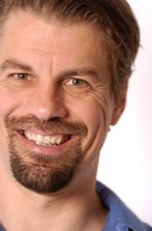
Performance Factors Analysis
First member of the LKT family that ran in real-time (Pavlik et al., 2009)

Slide 58
PFA
Measures how much latent skill a student has, while they are learning
But expresses it in terms of probability of correctness, the next time the skill is encountered
No direct expression of the amount of latent skill, except this probability of correctness

Slide 59
What is the typical use of PFA?
Assess a student’s knowledge of topic X
Based on a sequence of items that are dichotomously scored
E.g. the student can get a score of 0 or 1 on each item
Where the student can learn on each item, due to help, feedback, scaffolding, etc.

Slide 60
How does PFA differ from BKT?

Slide 61
Key assumptions
Each item may involve multiple latent skills or knowledge components
Different from BKT
Each skill has success learning rate γ and failure learning rate ρ
Different from BKT where learning rate is the same, success or failure

Slide 62
Key assumptions
There is also a difficulty parameter β, but its semantics can vary – more on this later
From these parameters, and the number of successes and failures the student has had on each relevant skill so far, we can compute the probability P(m) that the learner will get the item correct

Slide 63
PFA

Slide 64
PFA

Slide 65
Reasonable Example
γ = 0.2, ρ = 0.1, β = -0.5
Actual | m | P(m)

Slide 66
Reasonable Example
γ = 0.2, ρ = 0.1, β = -0.5
Actual | m | P(m)
 | -0.5 | 0.38

Slide 67
Reasonable Example
γ = 0.2, ρ = 0.1, β = -0.5
Actual | m | P(m)
0 | -0.5 | 0.38
 | -0.5+(0.1*1)

Slide 68
Reasonable Example
γ = 0.2, ρ = 0.1, β = -0.5
Actual | m | P(m)
0 | -0.5 | 0.38
 | -0.5+0.1

Slide 69
Reasonable Example
γ = 0.2, ρ = 0.1, β = -0.5
Actual | m | P(m)
0 | -0.5 | 0.38
 | -0.4 | 0.40

Slide 70
Reasonable Example
γ = 0.2, ρ = 0.1, β = -0.5
Actual | m | P(m)
0 | -0.5 | 0.38
0 | -0.4 | 0.40

Slide 71
Reasonable Example
γ = 0.2, ρ = 0.1, β = -0.5
Actual | m | P(m)
0 | -0.5 | 0.38
0 | -0.4 | 0.40
 | -0.5+(0.1*2)

Slide 72
Reasonable Example
γ = 0.2, ρ = 0.1, β = -0.5
Actual | m | P(m)
0 | -0.5 | 0.38
0 | -0.4 | 0.40
 | -0.5+0.2

Slide 73
Reasonable Example
γ = 0.2, ρ = 0.1, β = -0.5
Actual | m | P(m)
0 | -0.5 | 0.38
0 | -0.4 | 0.40
 | -0.3

Slide 74
Reasonable Example
γ = 0.2, ρ = 0.1, β = -0.5
Actual | m | P(m)
0 | -0.5 | 0.38
0 | -0.4 | 0.40
 | -0.3 | 0.43

Slide 75
Reasonable Example
γ = 0.2, ρ = 0.1, β = -0.5
Actual | m | P(m)
0 | -0.5 | 0.38
0 | -0.4 | 0.40
1 | -0.3 | 0.43

Slide 76
Reasonable Example
γ = 0.2, ρ = 0.1, β = -0.5
Actual | m | P(m)
0 | -0.5 | 0.38
0 | -0.4 | 0.40
1 | -0.3 | 0.43
 | -0.5+(0.1*2)+(0.2*1)

Slide 77
Reasonable Example
γ = 0.2, ρ = 0.1, β = -0.5
Actual | m | P(m)
0 | -0.5 | 0.38
0 | -0.4 | 0.40
1 | -0.3 | 0.43
 | -0.5+0.2+0.2

Slide 78
Reasonable Example
γ = 0.2, ρ = 0.1, β = -0.5
Actual | m | P(m)
0 | -0.5 | 0.38
0 | -0.4 | 0.40
1 | -0.3 | 0.43
 | -0.1 | 0.48

Slide 79
Degeneracy in PFA (Maier et al., 2021)
Three degenerate cases
γ < 0
γ < ρ
γ = ρ = 0

Slide 80
Degeneracy in PFA (Maier et al., 2021)
Three degenerate cases
γ < 0
γ < ρ
γ = ρ = 0
One seemingly degenerate (but not) case
4. ρ > 0
“It is worth noting that a fourth case when ρ > 0 -- is not degenerate, due to the multiple functions the parameters perform in PFA. In this case, the rate of learning the skill may outweigh the evidence of lack of student knowledge that an incorrect answer provides. So long as γ > ρ, a positive ρ is conceptually acceptable.”

Slide 81
Degenerate Example (Case 1)
γ = -0.1, ρ = -0.5, β = -0.5
Actual | m | P(m)
0 | -0.5 | 0.38
0 | -1 | 0.27
1 | -1.5 | 0.18
 | -1.6 | 0.17

Slide 82
Degenerate Example (Case 2)
γ = 0.1, ρ = 0.2, β = -0.5
Actual | m | P(m)
0 | -0.5 | 0.38
0 | -0.3 | 0.43
1 | -0.1 | 0.48
 | 0 | 0.5

Slide 83
Note
Values of ρ below 0 don’t actually mean negative learning
They mean that failure provides more evidence on lack of knowledge
Than the learning opportunity causes improvement
Notes:
Minor edit on this slide

Slide 84
Addressing Degeneracy (Maier et al., 2021)
Simply bound γ and ρ
Does not reduce model performance substantially (just like BKT)
What causes degeneracy?
We’ll come back to this in a minute

Slide 85
Note
Parameters in PFA combine information from correctness with improvement from practice improvement
Makes PFA models a little harder to interpret than BKT

Slide 86
Adjusting β
γ = 0.2, ρ = 0.1, β = -0.5
Actual | m | P(m)
0 | -0.5 | 0.38
0 | -0.4 | 0.40
1 | -0.3 | 0.43
 | -0.1 | 0.48

Slide 87
Adjusting β
γ = 0.2, ρ = 0.1, β = -1.5
Actual | m | P(m)
0 | -1.5 | 0.18
0 | -1.4 | 0.20
1 | -1.3 | 0.21
 | -1.1 | 0.25

Slide 88
Adjusting β
γ = 0.2, ρ = 0.1, β = +3.0
Actual | m | P(m)
0 | 3.0 | 0.953
0 | 3.1 | 0.957
1 | 3.2 | 0.961
 | 3.4 | 0.968

Slide 89
β Parameters
Pavlik proposes three different β Parameters
Item
Item-Type
Skill
Result in different number of parameters
And greater or lesser potential concern about over-fitting

Slide 90
Causes of Degeneracy (Maier et al., 2021)
If β is used at the Skill or Item-Type level
And the learning system moves students from easier to harder items within a “skill”
Then γ < 0.
Also, if items are tagged with multiple skills, shared variance (collinearity) between skills could produce degenerate parameters.

Slide 91
Fitting PFA
Typically Expectation Maximization is used

Slide 92
Expectation Maximization
Starts with initial values for each parameter
Estimates student correctness at each problem step
Estimates params using student correctness estimates
If goodness is substantially better than last time it was estimated, and max iterations has not been reached, go to step 2

Slide 93
Expectation Maximization
EM is vulnerable to local minima
Randomized restart typically used

Slide 94
Is PFA better than BKT?
Approximately equal predictive power across a lot of studies (Pavlik et al., 2009; Gong et al., 2010; Baker et al., 2011; Pardos et al., 2011, 2012)
Different virtues and flaws – choose the one that better fits your goals

Slide 95
Is PFA used in the real world?
Yes, but by far fewer learning systems than BKT
Maier et al. (2021) discuss its use in Reveal Math 1

Slide 96
Using PFA in the real world
One issue in real-world use is handling rare skills, which can impact model inferences on common skills as well
Because PFA is used in cases with items tagged to multiple skills
(Maier et al., 2021) handle this by creating a “catch all” skill for rare skills
Using average parameters from all common skills also works

Slide 97
Final Thoughts on PFA
PFA is a competitor for measuring student skill, which predicts the probability of correctness rather than latent knowledge
Can handle multiple KCs for the same item, a big virtue

Slide 98
Beyond PFA

Slide 99
PFA-Decay (Gong et al., 2011)
Weights actions further back in order less strongly
Adds an evidence decay parameter δ
Substitutes
For the previous summation
Very slightly higher AUC (0.003)

Slide 100
R-PFA (Galyardt & Goldin, 2014)
Weights actions further back in order less strongly
Looks at proportion of success-failure, weighting by distance in order from current action
Adds an evidence decay parameter b
Adds “ghost practices” before current practice to make math work
Substitutes
For the previous summation
A little higher AUC (0.003-0.027) (Pavlik et al., 2021)

Slide 101
LKT (Pavlik et al., 2021)
Creates a general framework for variants of PFA

Slide 102
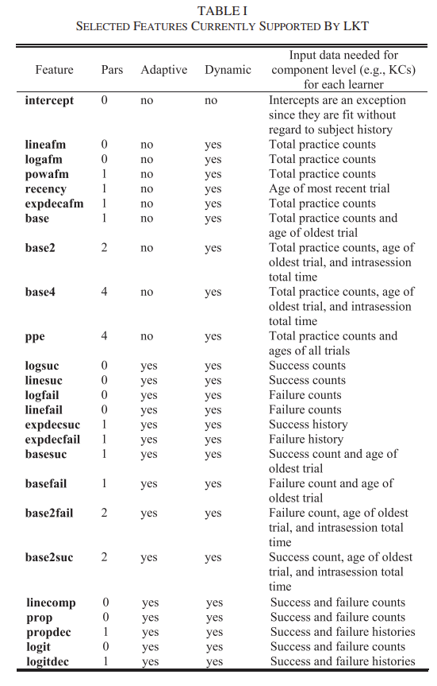

Slide 103
LKT (Pavlik et al., 2021)
New/ongoing work on variants to PFA typically frames itself in terms of LKT components (and proposes additional components)

Slide 104
Item Response Theory
A classic approach for assessment, used for decades in tests and some online learning environments
In its classical form, has some key limitations that make it less useful for assessment in online learning
But variants such as ELO and T-IRT address some of those limitations

Slide 105
Key goal of IRT
Measuring how much of some latent trait a person has
How intelligent is Bob?
How much does Bob know about snorkeling?
SnorkelTutor

Slide 106
Typical use of IRT
Assess a student’s current knowledge of topic X
Based on a sequence of items that are dichotomously scored
E.g. the student can get a score of 0 or 1 on each item

Slide 107
Key assumptions
There is only one latent trait or skill being measured per set of items
This assumption is relaxed in the extension Cognitive Diagnosis Models (CDM) (Henson, Templin, & Willse, 2009)
No learning is occurring in between items
E.g. a testing situation with no help or feedback

Slide 108
Key assumptions
Each learner has ability θ
Each item has difficulty b and discriminability a
From these parameters, we can compute the probability P(θ) that the learner will get the item correct

Slide 109
Note
The assumption that all items tap the same latent construct, but have different difficulties
Is a very different assumption than is seen in PFA or BKT

Slide 110
The Rasch (1PL) model
Simplest IRT model, very popular
Mathematically the same model (with a different coefficient), but some different practices surrounding the math (that are out of scope for this course)
There is an entire special interest group of AERA devoted solely to the Rasch model and modeling related to Rasch (Rasch Measurement)

Slide 111
The Rasch (1PL) model
No discriminability parameter
Parameters for student ability and item difficulty

Slide 112
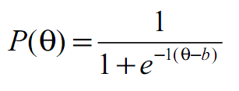
The Rasch (1PL) model
Each learner has ability θ
Each item has difficulty b

Slide 113
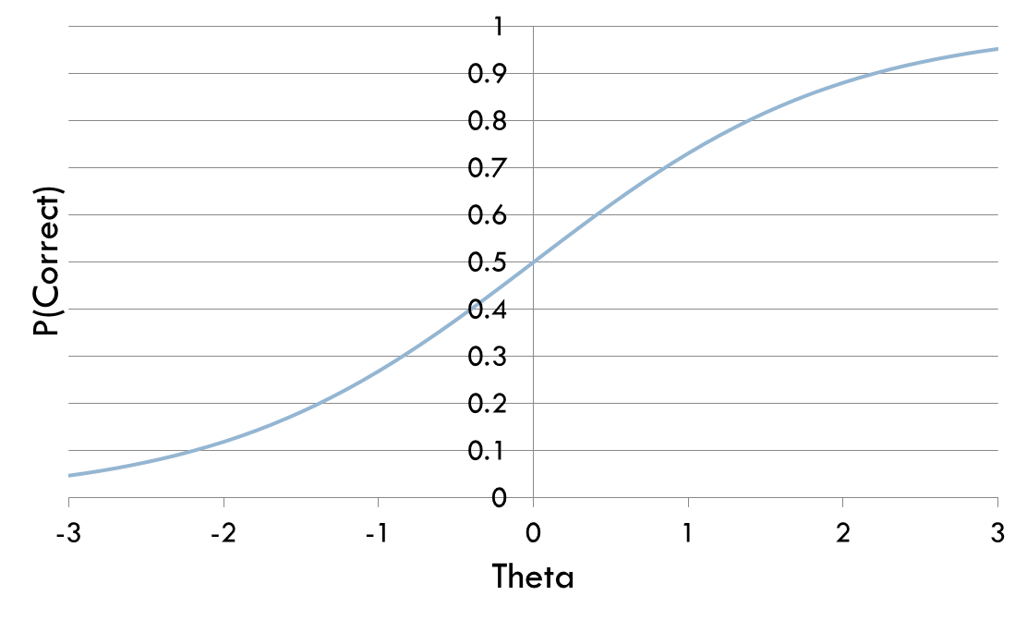
Item Characteristic Curve
A visualization that shows the relationship between student skill and performance

Slide 114
As student skill goes up, correctness goes up
This graph represents b=0
When θ=b (knowledge=difficulty), performance = 50%

Slide 115
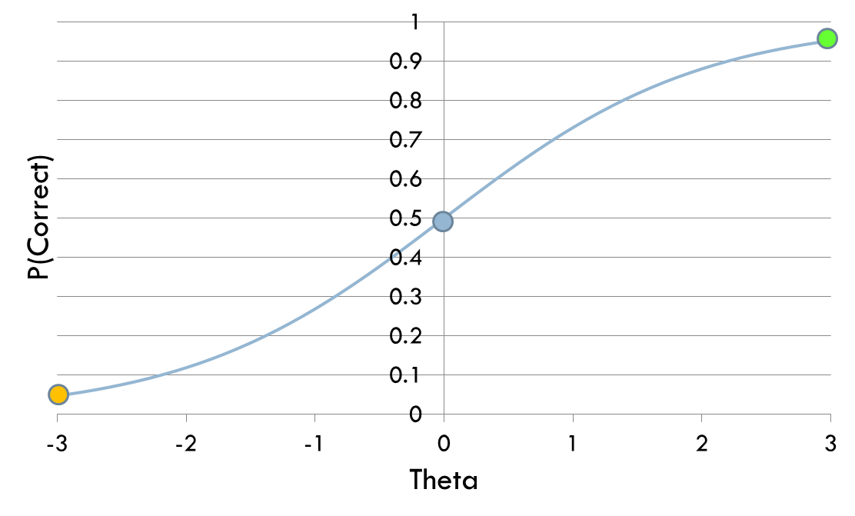
As student skill goes up, correctness goes up

Slide 116
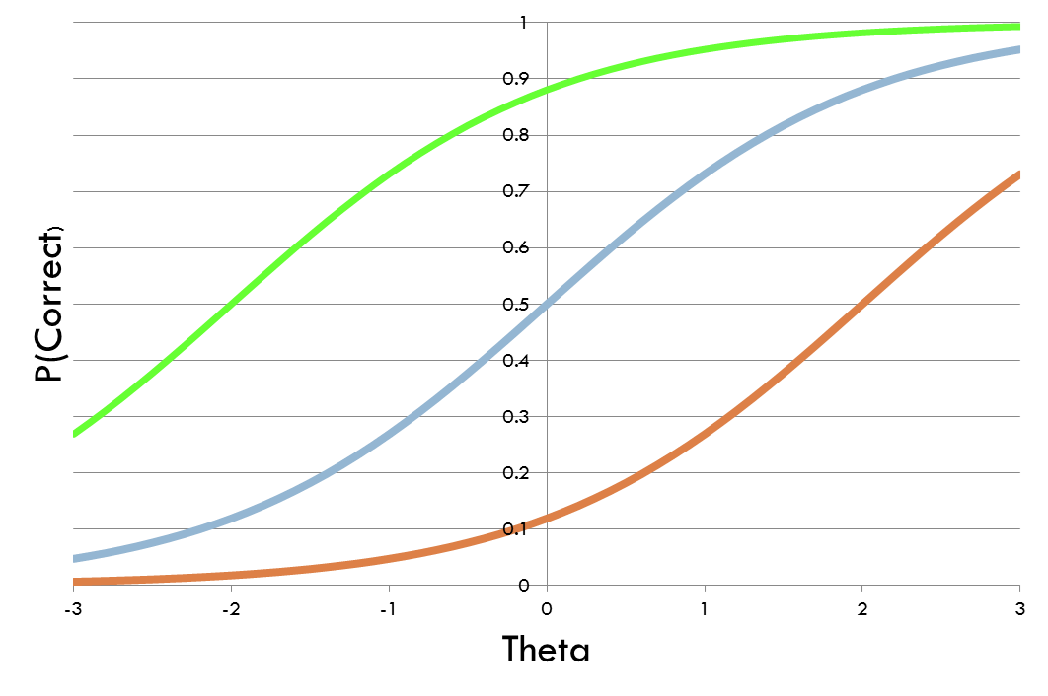
Changing difficulty parameter
Green line: b=-2 (easy item)
Orange line: b=2 (hard item)

Slide 117
Note
The good student finds the easy and medium items almost equally difficult

Slide 118
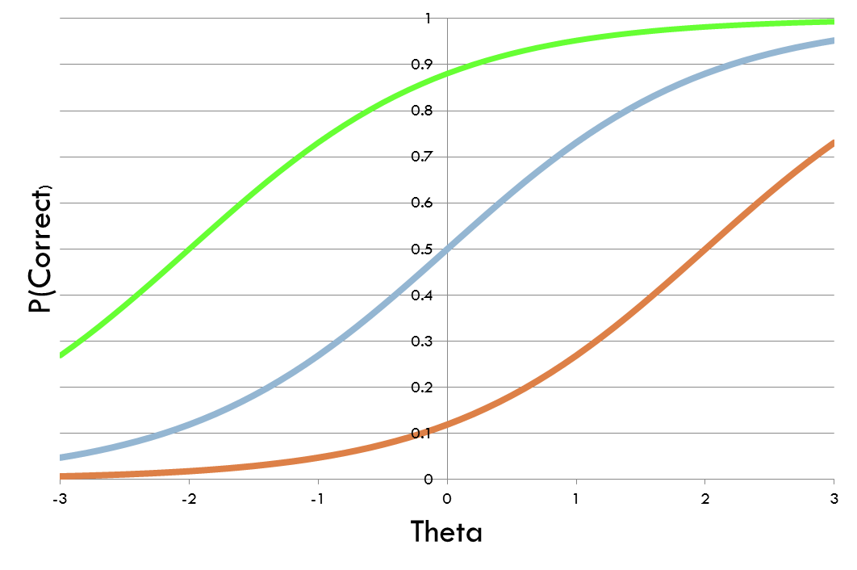
Note
The weak student finds the medium and hard items almost equally hard

Slide 119
Note
When b=θ
Performance is 50%

Slide 120
The 2PL model
Another simple IRT model, very popular
Discriminability parameter a added

Slide 121
Rasch
2PL

Slide 122
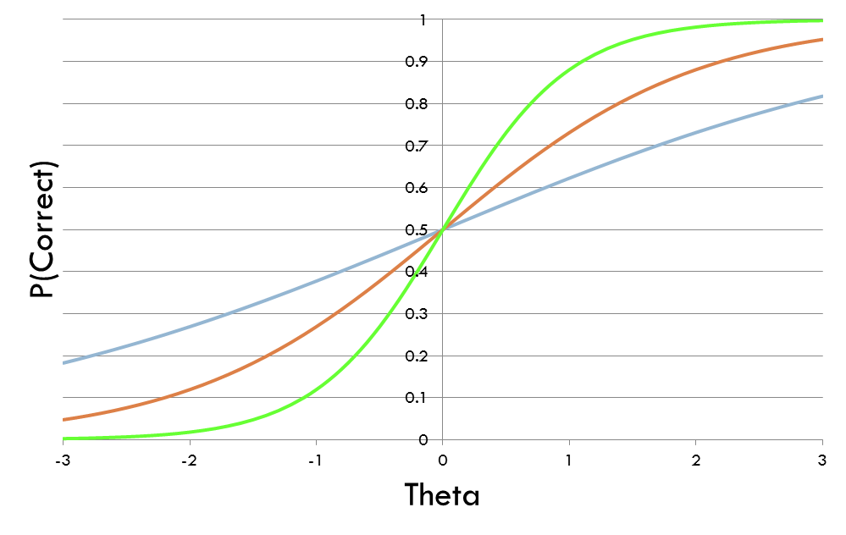
Different values of a
Green line: a = 2 (higher discriminability)
Blue line: a = 0.5 (lower discriminability)

Slide 123
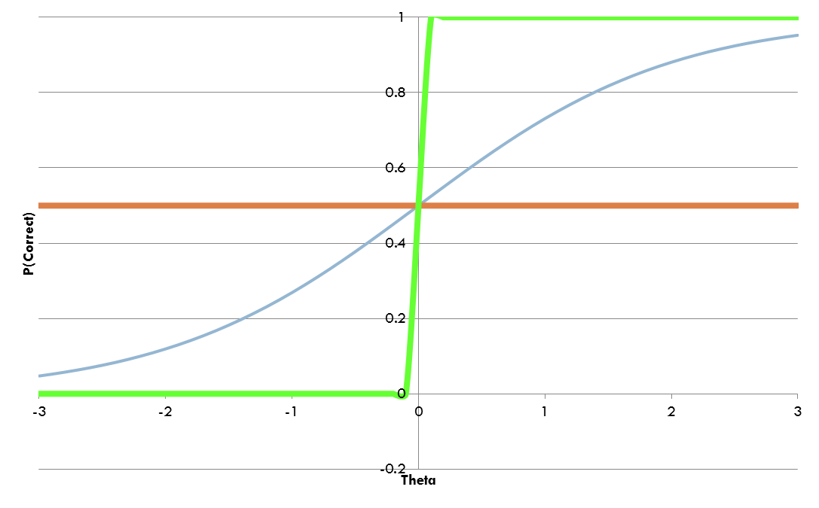
Extremely high and low discriminability
a=0
a approaches infinity

Slide 124
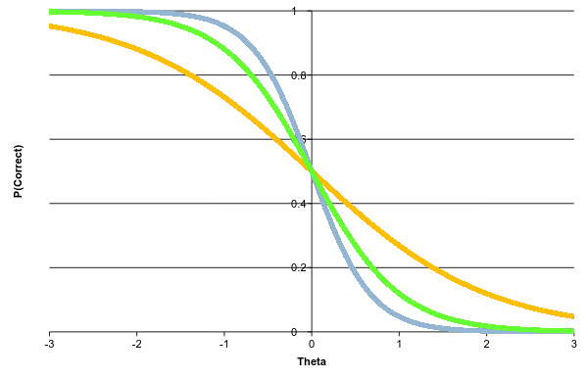
Model degeneracy
a below 0…

Slide 125
The 3PL model
A more complex model
Adds a guessing parameter c

Slide 126
The 3PL model
Either you guess (and get it right)
Or you don’t guess (and get it right based on knowledge)

Slide 127
Fitting an IRT model
Can be done with Expectation Maximization
As discussed in previous lectures
Estimate knowledge and difficulty together
Then, given item difficulty estimates, you can assess a student’s knowledge in real time

Slide 128
Uses…
IRT is used quite a bit in computer-adaptive testing
Not used quite so often in online learning, where student knowledge is changing as we assess it
For those situations, BKT and PFA are more popular

Slide 129
ELO (Elo, 1978; Pelanek, 2016)
A variant of the Rasch model which can be used in a running system
Continually estimates item difficulty and student ability, updating both every time a student encounters an item

Slide 130
ELO (Elo, 1978; Pelanek, 2016)

Slide 131
Multivariate ELO (Abdi et al., 2019)
Allows an item to involve multiple skills
Averages difficulty across skills

Slide 132
MV-Glicko (Abdi et al., 2021)
Allows an item to involve multiple skills
Averages difficulty across skills
Takes time between practices of a skill into account (much like LKT extensions to PFA)

Slide 133
Deep Knowledge Tracing (DKT) (Piech et al., 2015)
Based on long short term memory networks
Fits on sequence of student performance across skills
Predicts performance on future items within system
Can fit very complex functions
Very complex relationships between items over time

Slide 134
DKT
Initial paper reported massively better performance than original BKT or PFA (Piech et al., 2015)
Seemed at first too good to be true, and (Xiong et al., 2016) reported that (Piech et al., 2015) had used the same data points for both training and test

Slide 135
DKT
(Khajah et al., 2016) compared DKT to modern extensions to BKT on same data set
Particularly beneficial to re-fit item-skill mappings
(Wilson et al., 2016) compared DKT to temporal IRT on same data set
Bottom line: All three approaches appeared to perform comparably well

Slide 136
But this was the beginning of what could be called DKT-Family algorithms
A range of knowledge tracing algorithms based on different variants on Deep Learning
Now literally hundreds of published variants
Most of them tiny tweaks to get tiny gains in performance
But in aggregate, there appear to be some real improvements to predictive performance (see comparison in Gervet et al., 2020 for example)
I will discuss some of the key issues that researchers have tried to address, and what their approaches were

Slide 137
Degenerate behavior
(Yeung & Yeung, 2018) reported degenerate behavior for DKT
Getting answers right leads to lower knowledge
Wild swings in probability estimates in short periods of time

Slide 138
Degenerate behavior
(Yeung & Yeung, 2018) reported degenerate behavior for DKT
Getting answers right leads to lower knowledge
Wild swings in probability estimates in short periods of time
They proposed adding two types of regularization to moderate these swings
Increasing weight of current prediction for future prediction
Reducing amount model is allowed to change future estimates

Slide 139
Impossible to interpret in terms of skills
DKT Family predicts individual item correctness, not skills
What do you do for entirely new items?
What information can you provide teachers?

Slide 140
Extension for Latent Knowledge Estimation
(Zhang et al., 2017) proposed an extension to DKT, called DKVMN, that fits an item-skill mapping too
Based on Memory-Augmented Neural Network, that keeps an external memory matrix that neurons update and refer back to
Latent skill difficult to interpret

Slide 141
Extension for Latent Knowledge Estimation
(Lee & Yeung, 2019) proposed an alternative to DKT, called KQN, that attempts to output more interpretable latent skill estimates
Again, fits an external memory network to fit skills
Also attempts to fit amount of information transfer between skills
Still not that interpretable

Slide 142
Extension for Latent Knowledge Estimation
(Scruggs et al., 2020) proposed an extension to any DKT-family algorithm
Human-derived skill-item mapping used
Predicted performance on all items in skill averaged
Including both unseen and already-seen items
Led to successful prediction of post-tests outside the learning system

Slide 143
What is DKT really learning?
Ding & Larson (2019) demonstrated theoretically that a lot of what DKT learns is how good a student is overall

Slide 144
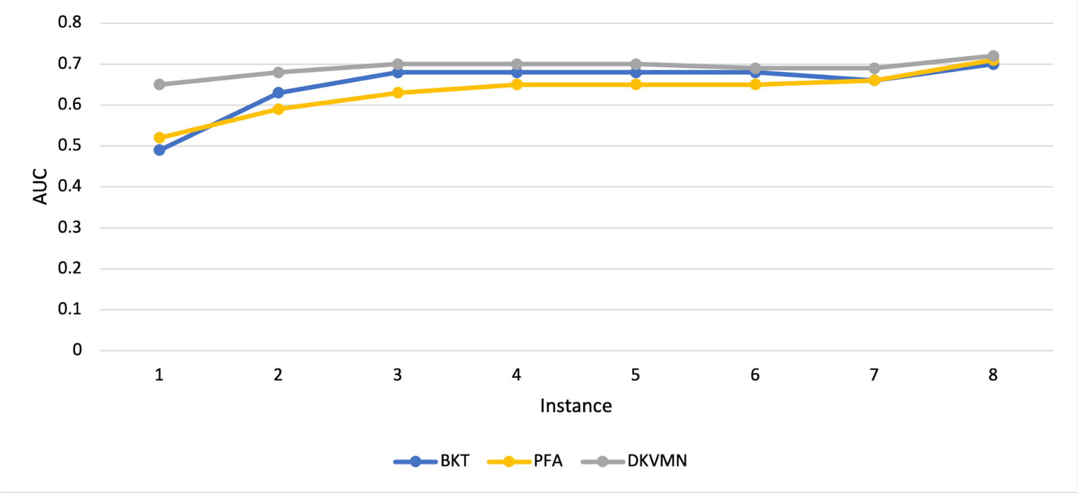
What is DKT really learning?
Zhang et al. (2021) followed this up with empirical work showing that most of the improvement in performance for DKVMN is in the first attempt on a new skill

Slide 145
What is DKT really learning?
In particular, there’s essentially no benefit to deep learning after several attempts on a skill (about the point where students often reach mastery, if they didn’t already know skill)

Slide 146
Other Important DKT variants: SAKT
Pandey & Karypis (2019) proposed a DKT variant, called SAKT, which fits attentional weights between exercises and more explicitly predicts performance on current exercise from performance on past exercises
Gets a little better fit, doubles down a little more on some limitations we’ve already discussed

Slide 147
Other Important DKT variants: AKT
Ghosh et al. (2020) proposed a DKT variant, called AKT, which
Explicitly stores and uses learner’s entire past practice history for each prediction
Uses exponential decay curve to downweight past actions
Uses Rasch-model embeddings to calculate item difficulty

Slide 148
Adding in more information: SAINT+
Shin et al. (2021) added elapsed time and lag time as additional inputs, leading to better performance

Slide 149
Adding in more information: Process-BERT
Scarlatos et al. (2022) added timing and use of resources such as calculator
Additional information leads to better performance

Slide 150
Curious methodological note
Most DKT-family papers report large improvements over previous algorithms, including other DKT-family algorithms
Improvements that seem to mostly or entirely dissipate in the next paper

Slide 151
Some reasons
Poor validation and over-fitting
A lot of DKT-family papers don’t use student-level cross-validation
Poor cross-validation benefits DKT-family algorithms more than other algorithms, because DKT-family fits more aggressively
A lot of DKT-family papers fit their own hyperparameters but use past hyperparameters for other algorithms

Slide 152
An evaluation
Gervet et al. (2020) compares KT algorithms on several data sets
Key findings
Different data sets have different winners
DKT-family performs better than other algorithms on large data sets, but worse on smaller data sets
DKT-family algorithms perform worse than LKT-family on data sets with very high numbers of practices per skill (i.e. language learning)
DKT-family algorithms do better at predicting if exact order of items matters (which can occur if items within a skill vary a lot)
DKT-family algorithms reach peak performance faster than other algorithms (also seen in Zhang et al., 2021)

Slide 153
Next Frontier for DKT-family: Beyond Correctness
Option Tracing (Ghosh et al., 2021) extends output layer to predict which multiple choice item the student will select

Slide 154
Next Frontier for DKT-family: Beyond Correctness
Open-Ended Knowledge Tracing (Liu et al., 2022) integrates KT with
A GPT-2 model fine-tuned on 2.1 million Java code exercises and written descriptions of them
In order to generate predicted student code which makes predicted specific errors

Slide 155
DKT-family: work continues
Dozens of recent papers trying to get better results by adjusting the deep learning framework in various ways

Slide 156
Is future correctness enough?
Up until this point we’ve been talking about predicting future correctness

Slide 157
But what if you forget it tomorrow?
Another way to look at knowledge is – how long will you remember it?

Slide 158
Relevant for all knowledge
Mostly studied in the context of memory for facts, rather than skills
How do you say banana in Spanish?
What is the capital of New York?
Where are the Islands of Langerhans?

Slide 159
Spacing Effect
It has long been known that spaced practice (i.e. pausing between studying the same fact) is better than massed practice (i.e. cramming)
Early adaptive systems implemented this behavior in simple ways (i.e. Leitner, 1972)

Slide 160
ACT-R Memory Equations (Pavlik & Anderson, 2005)
Memory duration can be understood in terms of memory strength (referred to as activation)

Slide 161
ACT-R Memory Equations (Pavlik & Anderson, 2005)

Slide 162
ACT-R Memory Equations (Pavlik & Anderson, 2005)

Slide 163
ACT-R Memory Equations (Pavlik & Anderson, 2005)
Implications
More practice = better memory
More time between practices = better memory
Most efficient learning comes from dense practice followed by expanding amounts of time in between practices (Pavlik & Anderson, 2008)

Slide 164
MCM (Mozer et al., 2009)
Postulates that decay speed drops, the more times a fact is encountered
Functionally complex model where
Knowledge strength (and therefore probability of remembering) is a function of the sum of the traces’ actual contributions, divided by the product of their potential contributions
Power function is estimated as a combination of exponential functions

Slide 165
DASH (Mozer & Lindsay, 2016)
DASH Extends previous approaches to also include item difficulty and latent student ability
Can use either MCM or ACT-R as its internal representation of how memory decays over time

Slide 166
Duolingo (Settles & Mercer, 2016)
Fits regression model to predict both recall and estimated half-life of memory (based on lag time)
Based on estimate of exponential decay of memory

Slide 167
Duolingo (Settles & Mercer, 2016)
Uses feature set including
Time since word last seen
Total number of times student has seen the word
Total number of times student has correctly recalled the word
Total number of times student has failed to recalled the word
Word difficulty

